Slide 1
Neural networks and how to fool them
Christophe Jefferies

Slide 2
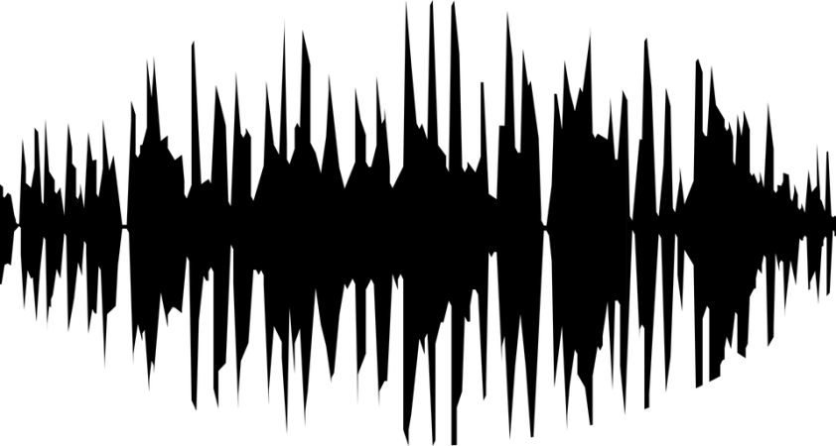
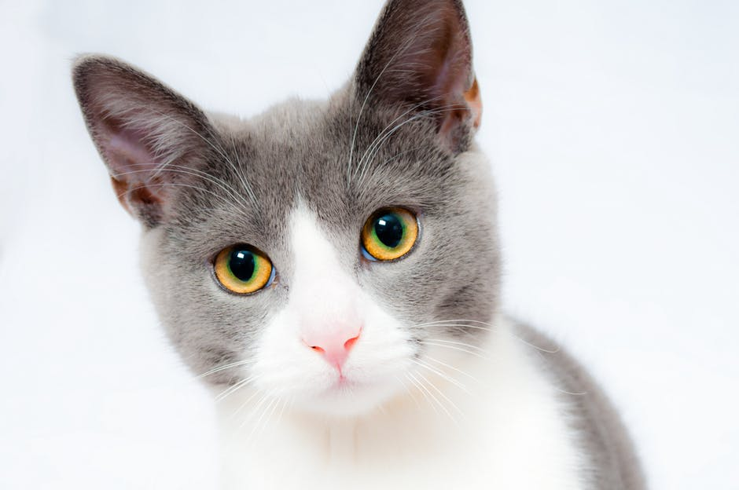
Success stories
“My name is Christophe”
Cat

Slide 3
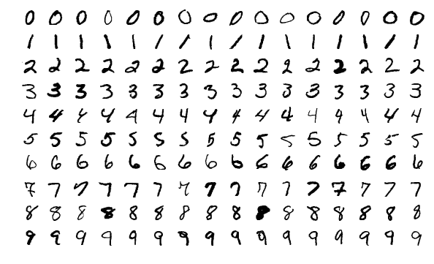
Example: reading hand-written digits
Different digits,
many shared pixels
Same digits,
very different pixels

Slide 4
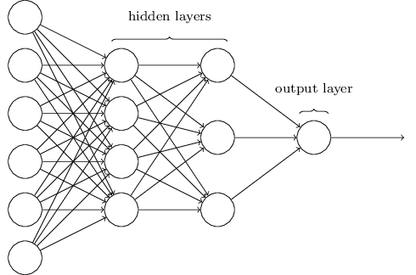
Neural network structure
“Five”

Slide 5
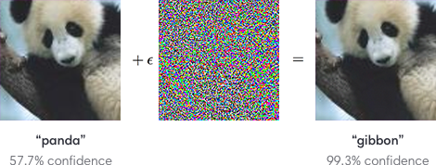
Fooling a neural network

Slide 6
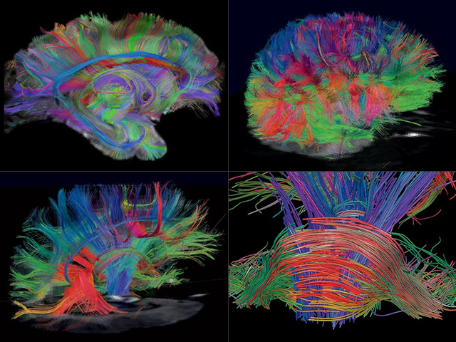

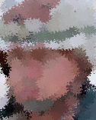
Applications
Medical scans and diagnoses
Military face-concealing

